Slide 1



Surgical Treatment of Asymptomatic
Carotid Stenosis
Lazar B. Davidovic MD, PhD, FETCS
Professor of Vascular Surgery
School of Medicine, University of Belgrade
Head of the Clinic for Vascular and Endovascular Surgery Clinical Center of Serbia

Slide 2
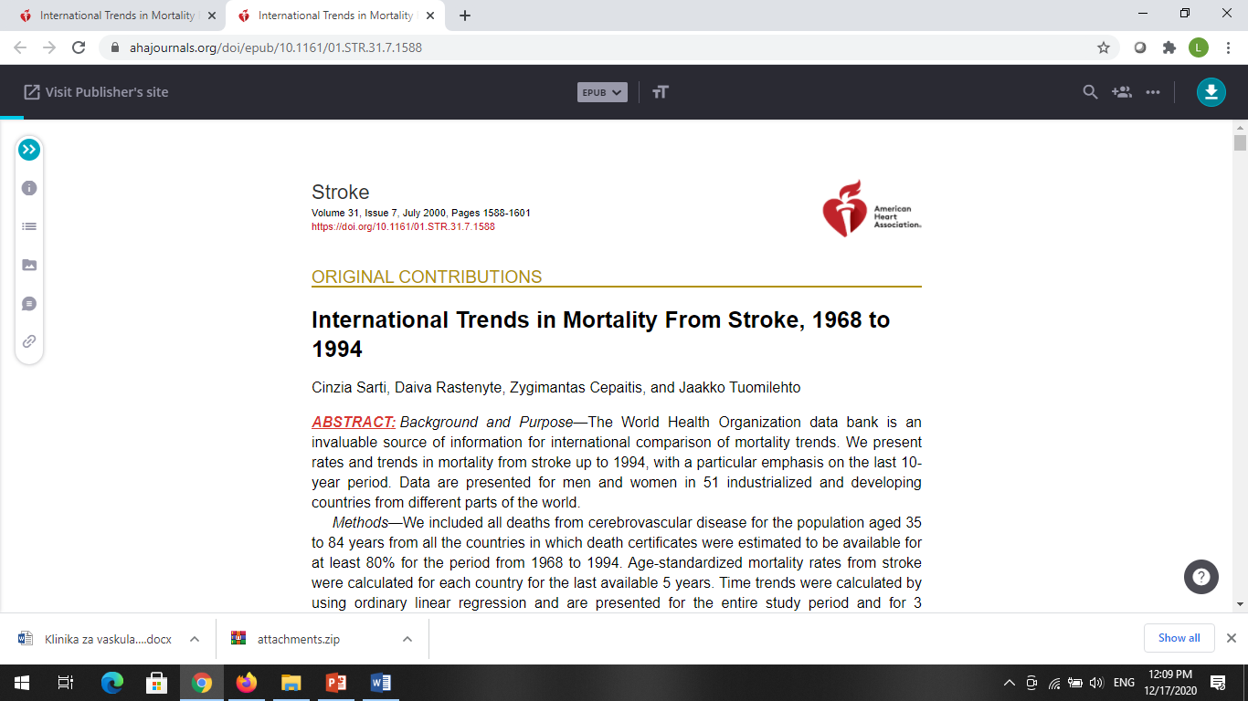
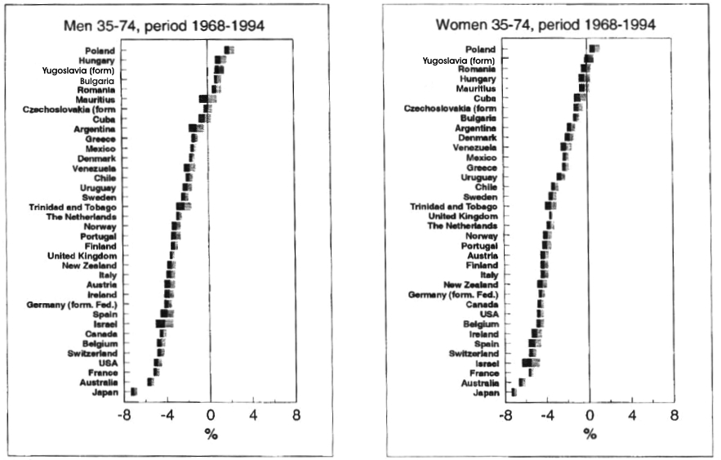


Slide 3
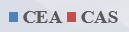

Slide 4
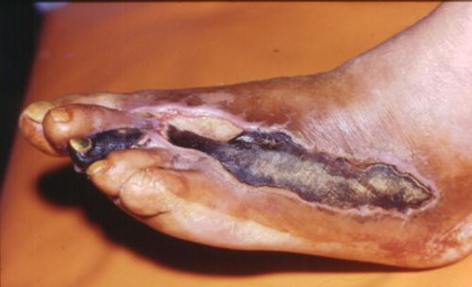
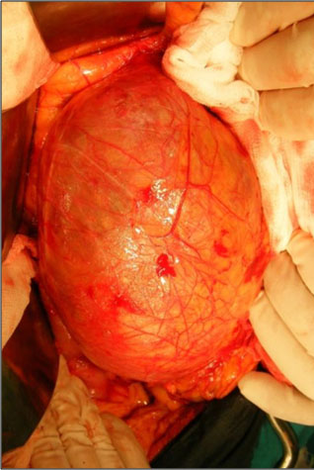
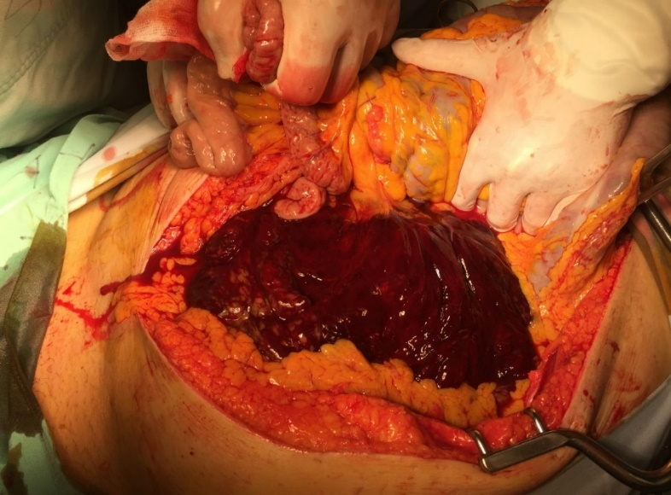
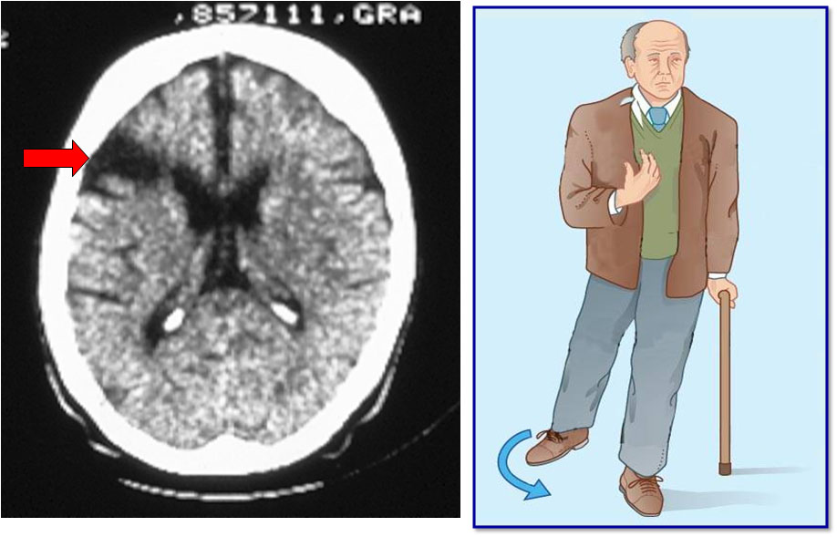
Asymptomatic Patients
•Primum non nocere!

Slide 5
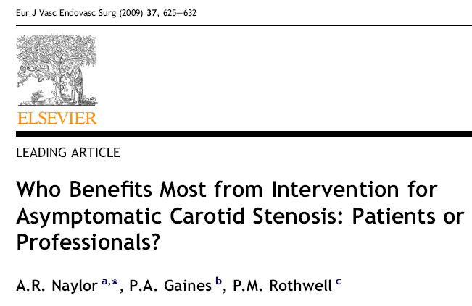

Slide 6
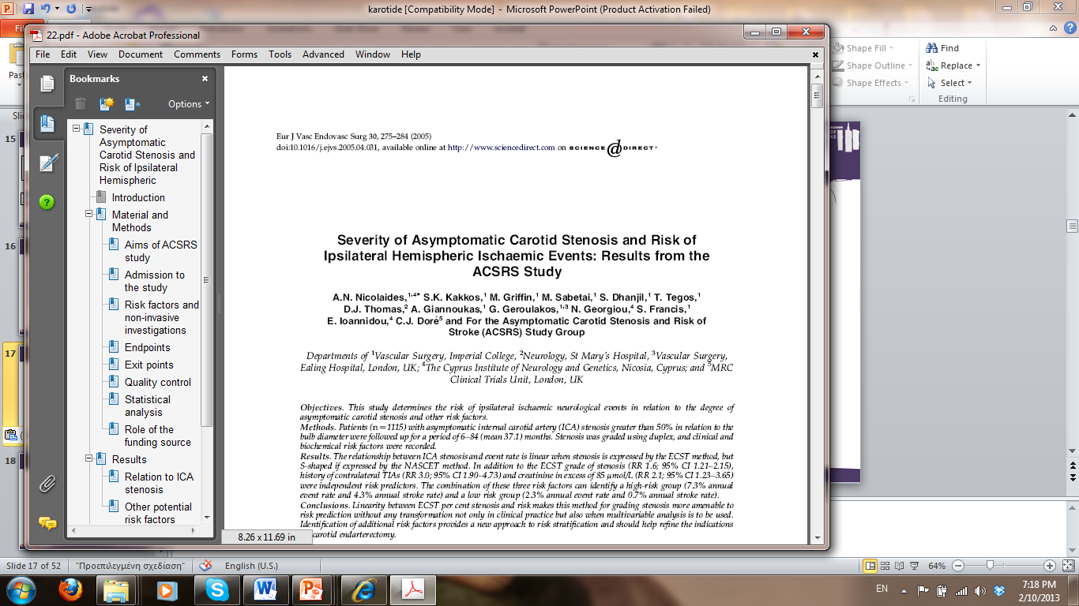
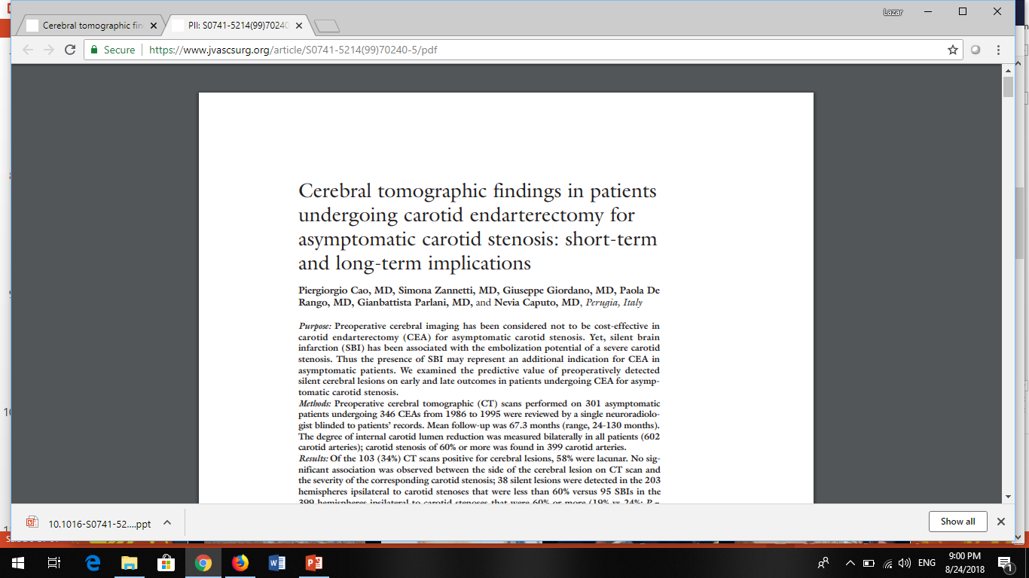
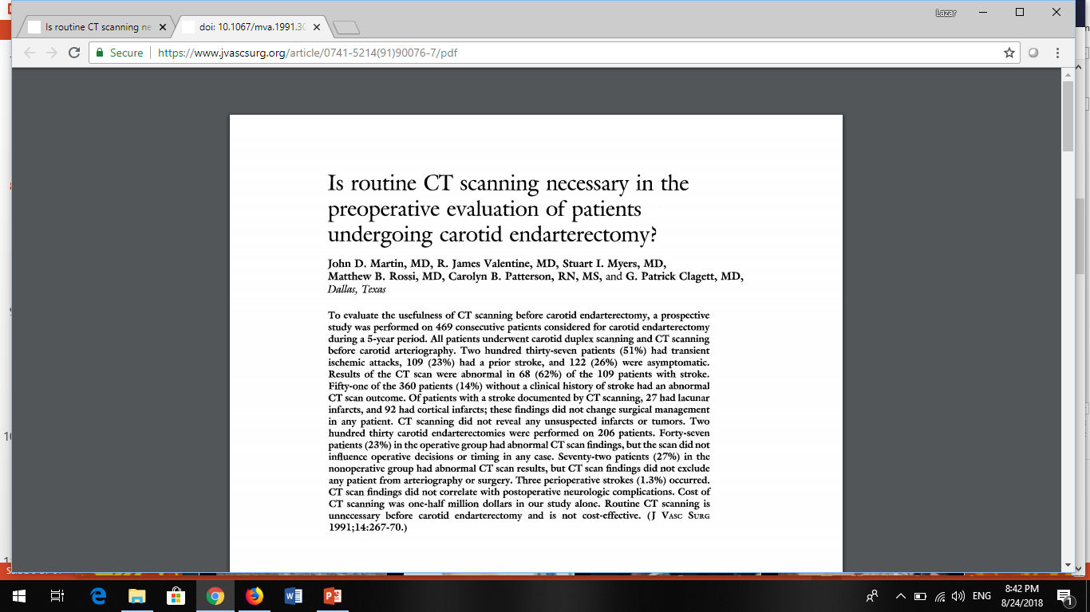
“Silent” Brain Infarction
·Prevalence: 14-18%.
Asymptomatic Carotid
Stenosis >70%
J Vasc Surg 1999; 29:995-1005.
·Annual Stroke Risk: 3.6%.
Asymptomatic Carotid
Stenosis >60%
J Vasc Surg 1991; 14:267-70.

Slide 7
•3200 patients
•1st group: Asymptomatic
•2nd group: Symptomatic

Slide 9
Male younger than 75 y

Slide 10
Female younger than 75 y

Slide 11
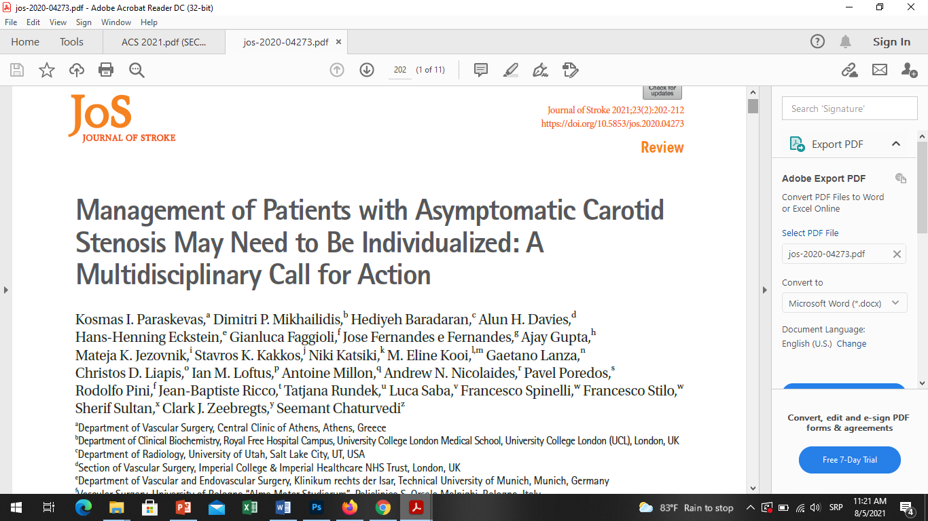
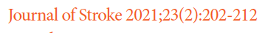
Intervention for asymptomatic carotid stenosis: Pro et Contra
1. Age and Life Expectancy
2. Gender
3. Comorbidity
4. Risk Factors
5. Contralateral Disease
6. Carotid Plaque Morphology
7. Concomitant Operations
8. Surgeon/Hospital Volume

Slide 12
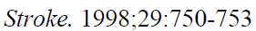
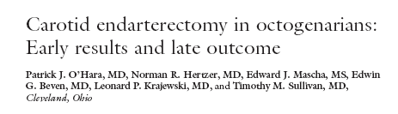
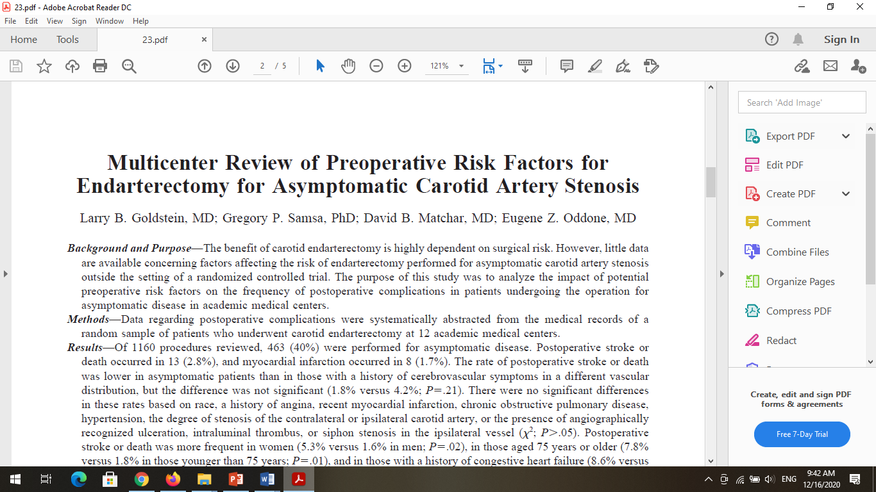
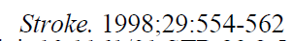
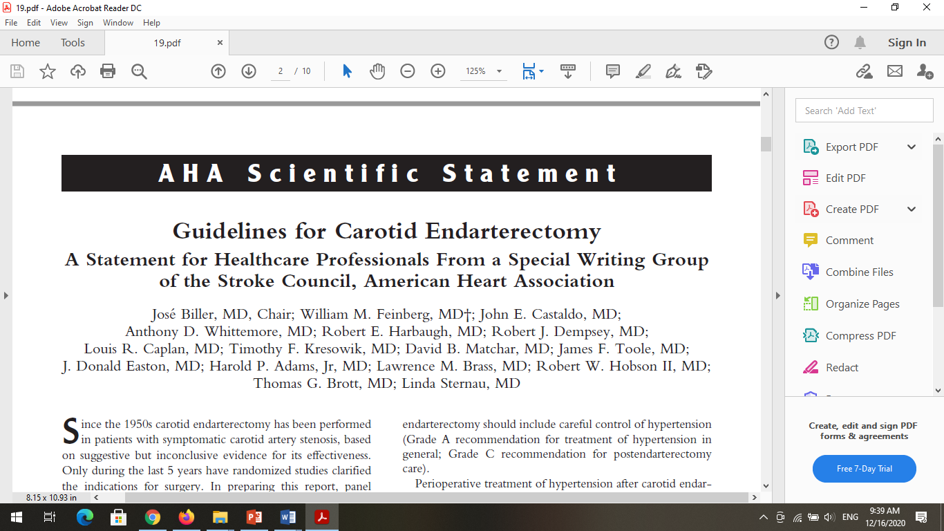
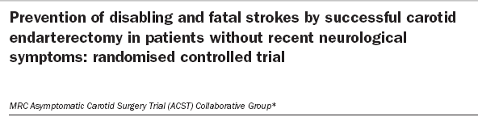

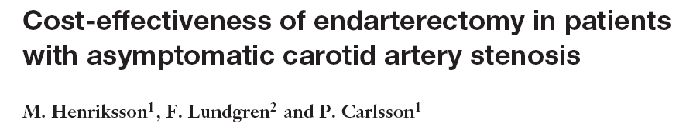
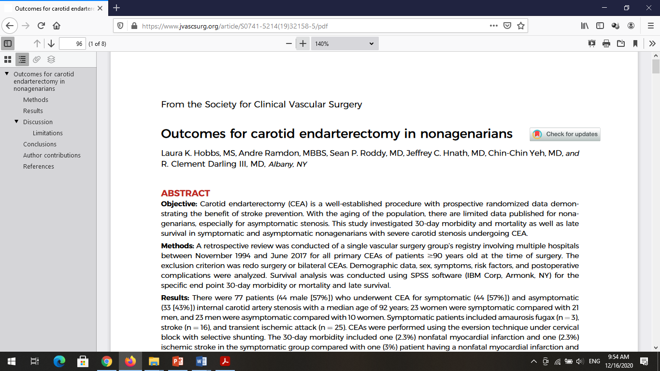
1. Age
J Vasc Surg 1998, 27:860-71.
Lancet 2004, 363:1491-502.
J Vasc Surg 2020;71:96-103.
•CEA is not recommendable at elderly patient with asymptomatic carotid stenosis.

Slide 13
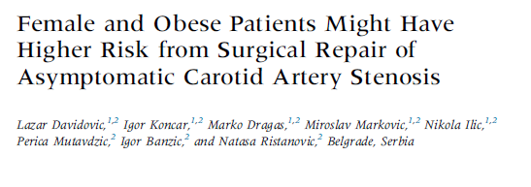
Ann Vasc Surg 2015, 29 (6):1286-1292.
Carotid Procedures: 2007-2012
-3497-
Symptomatic
Asymptomatic

Slide 14
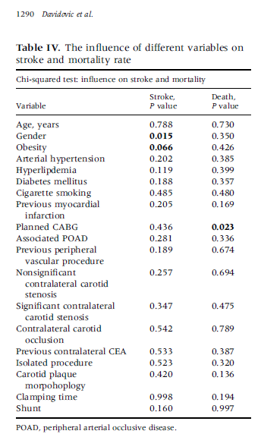
1. Age
Ann Vasc Surg 2015, 29 (6):1286-1292.

Slide 15
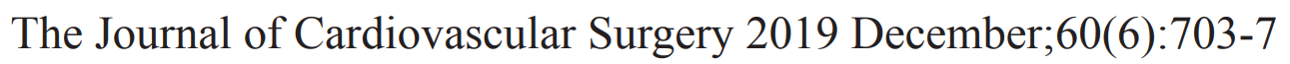
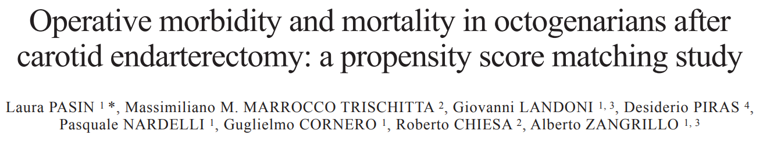
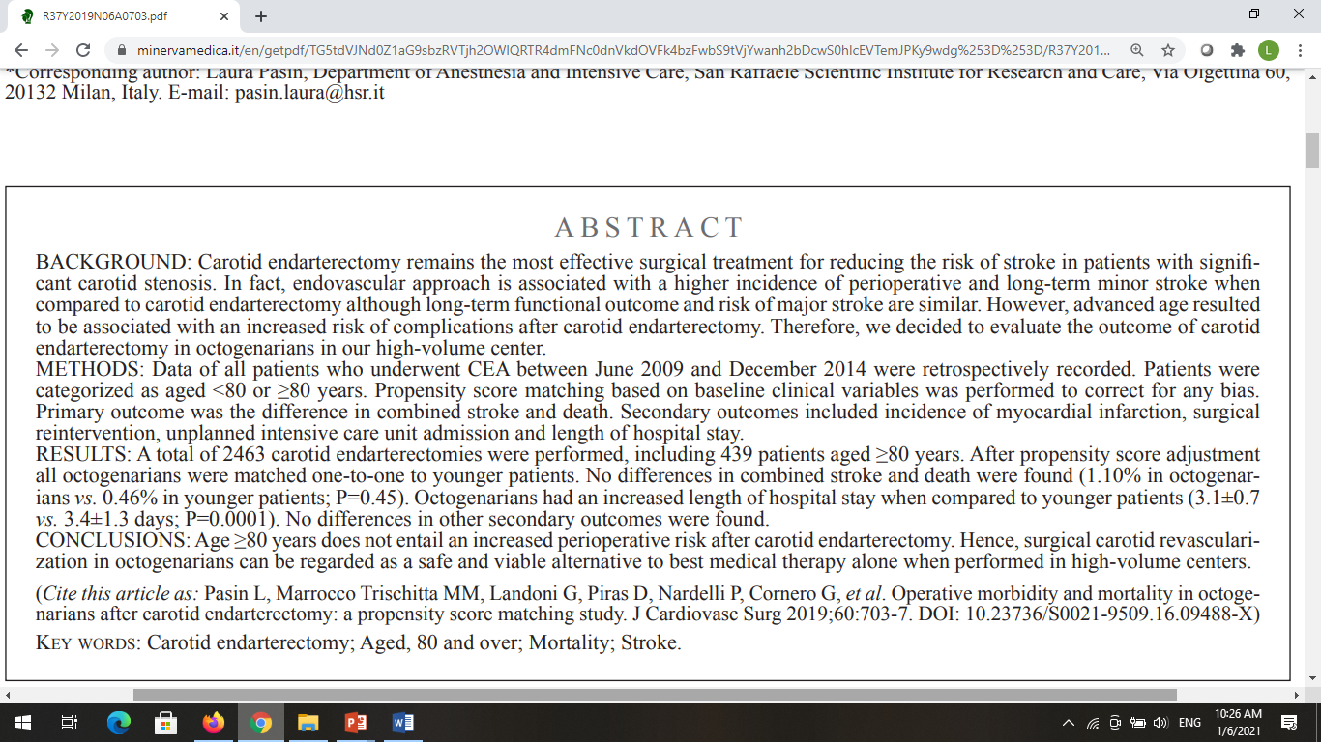
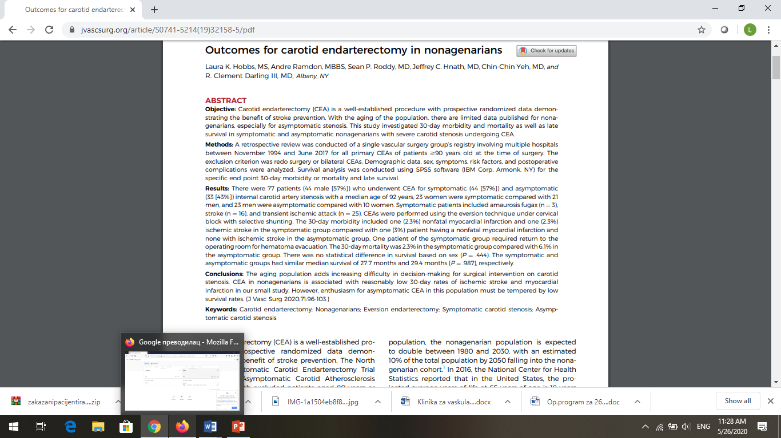
1. Age
J Vasc Surg 2020;71:96-103.
J Vasc Surg 2020, 71: 96-103.

Slide 16
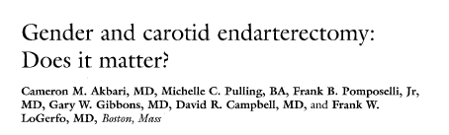
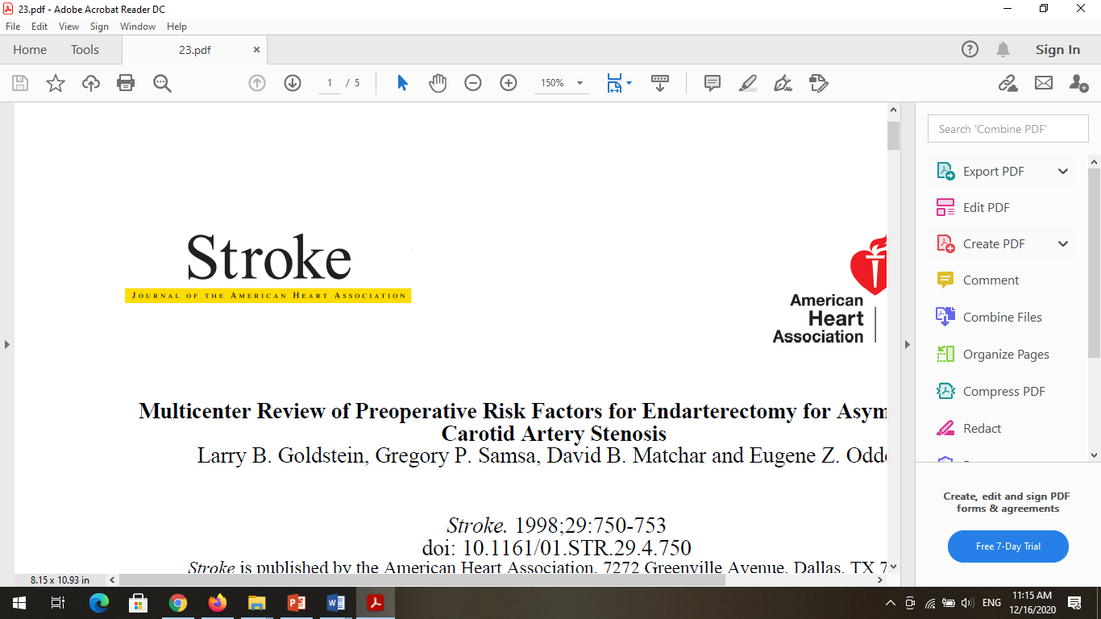
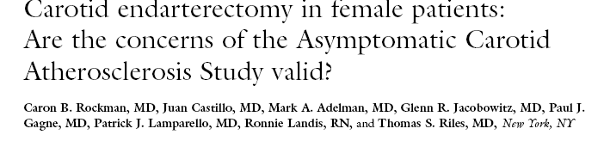
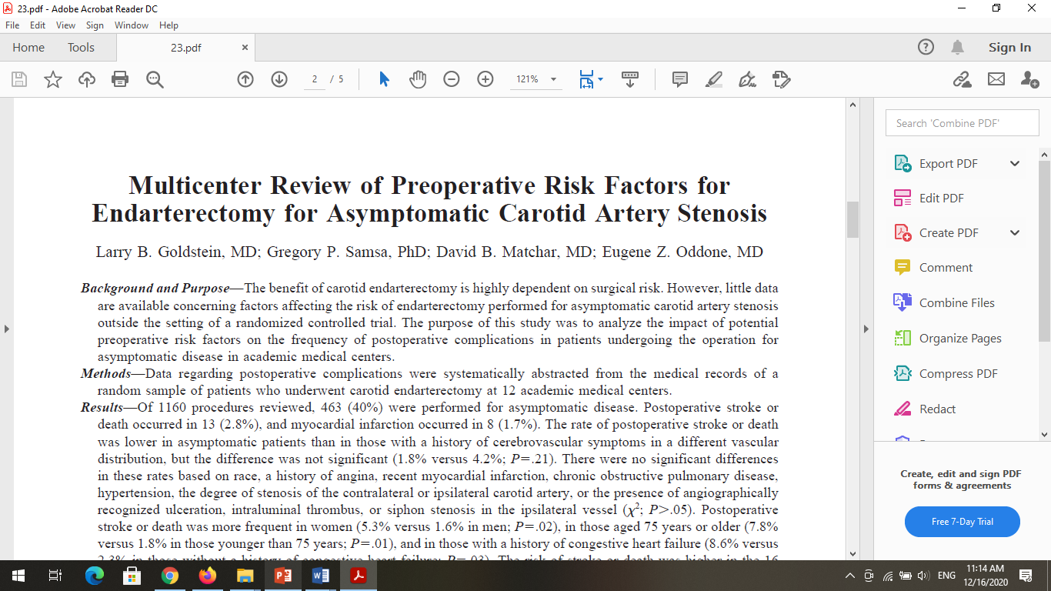
2. Gender
•Does gender matter after CEA performed for asymptomatic carotid stenosis?
Yes
No
J Vasc Surg 2000, 31:1103-9.
J Vasc Surg 2001, 33:236-41.

Slide 17
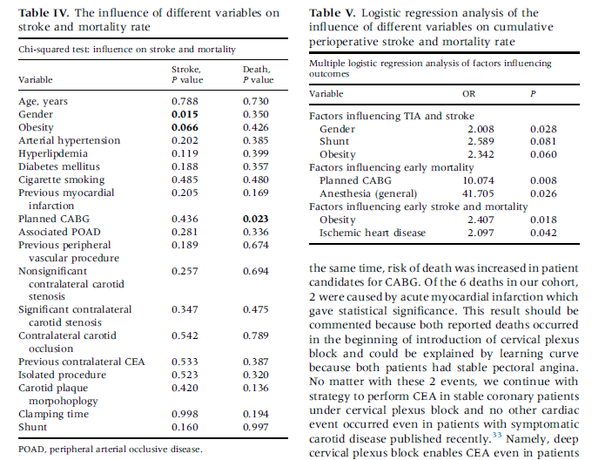
Ann Vasc Surg 2015, 29 (6):1286-1292.
2. Gender

Slide 18
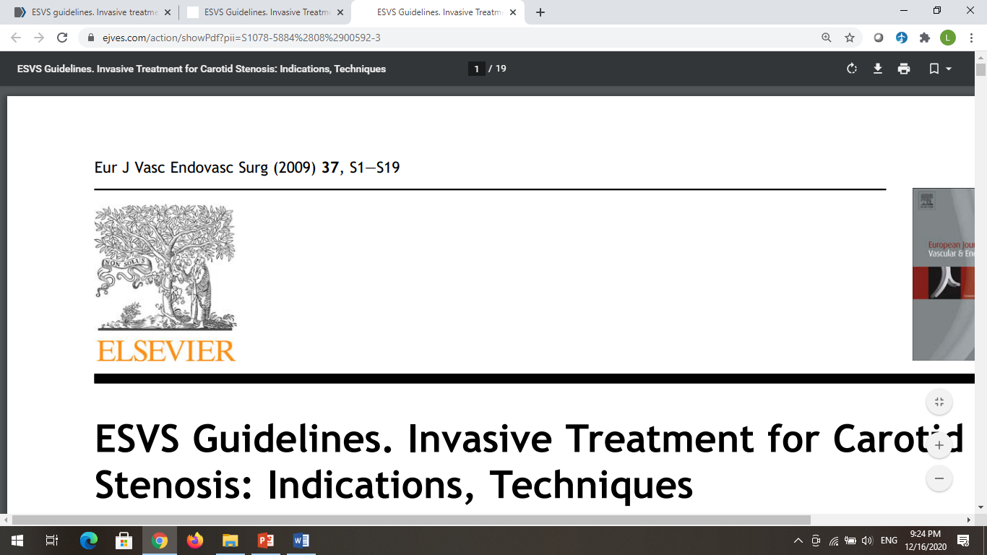
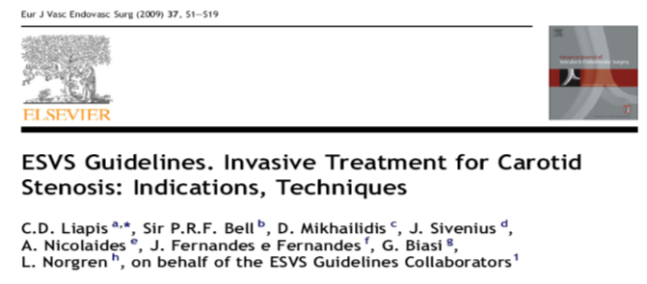

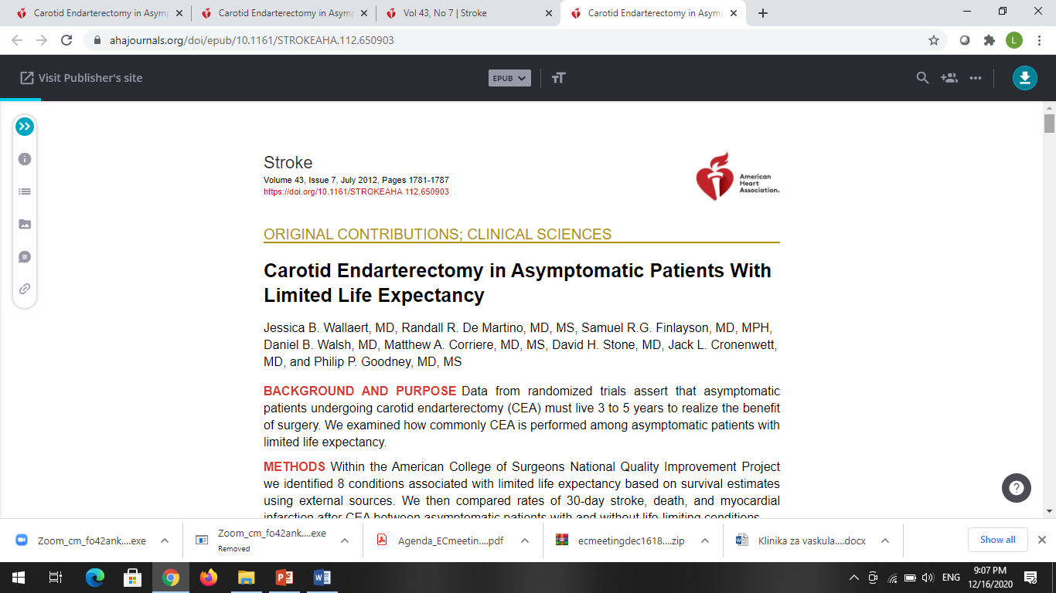
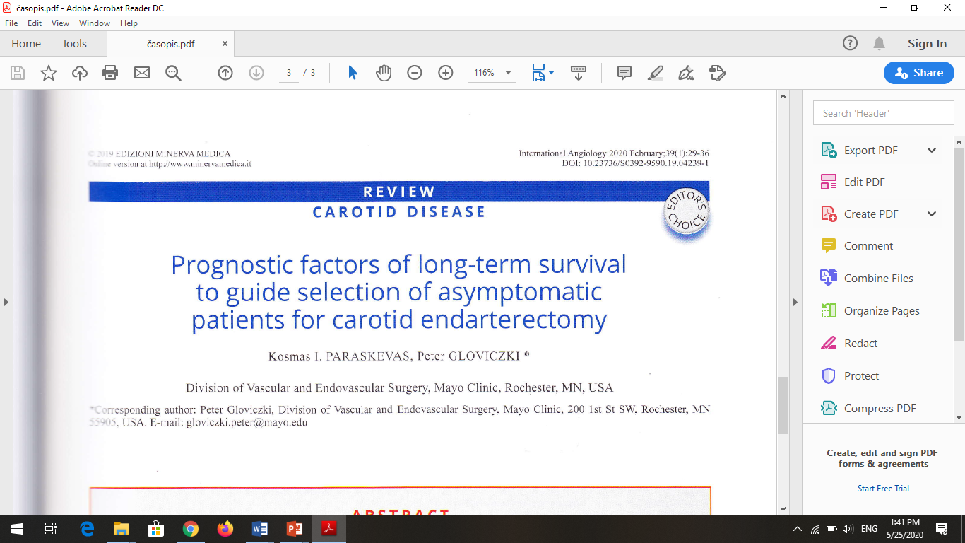
3. Comorbidity
•CEA is not recommendable in patients with asymptomatic carotid stenosis that have life limiting conditions.

Slide 19
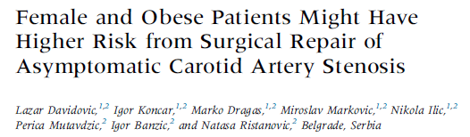
Ann Vasc Surg 2015, 29 (6):1286-1292.
4. Obesity

Slide 20
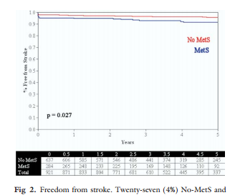
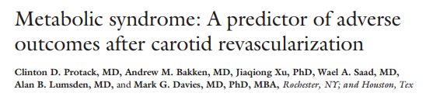
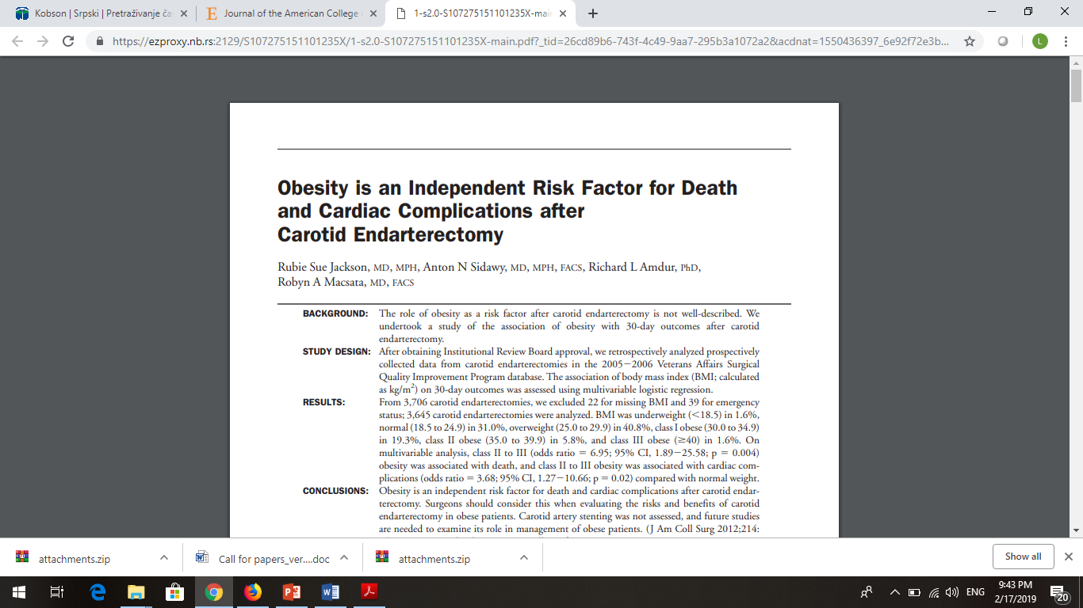
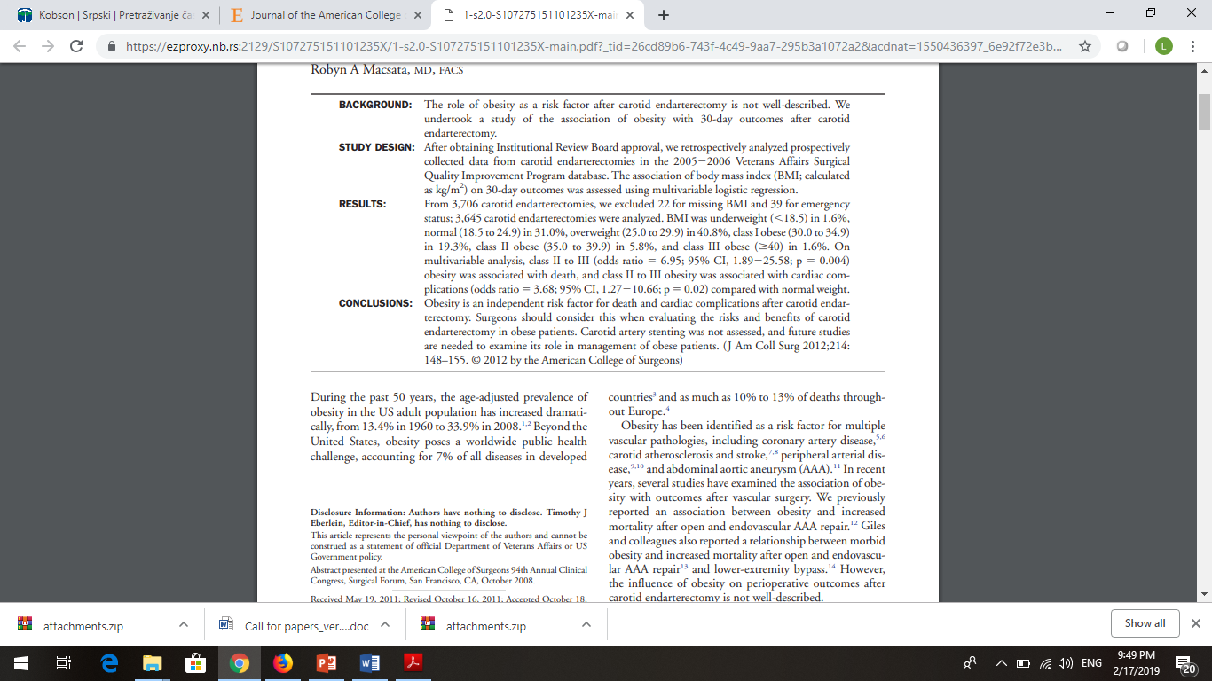
4. Obesity
J Vasc Surg 2009, 49:1172-80.
J Am Coll Surg 2012, 214:148-155.

Slide 21
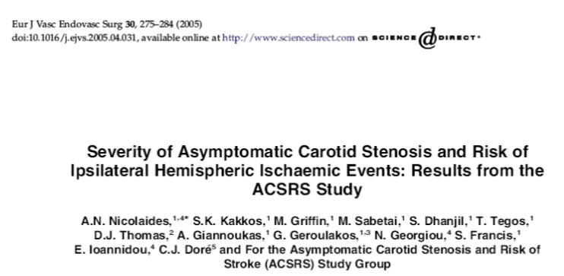
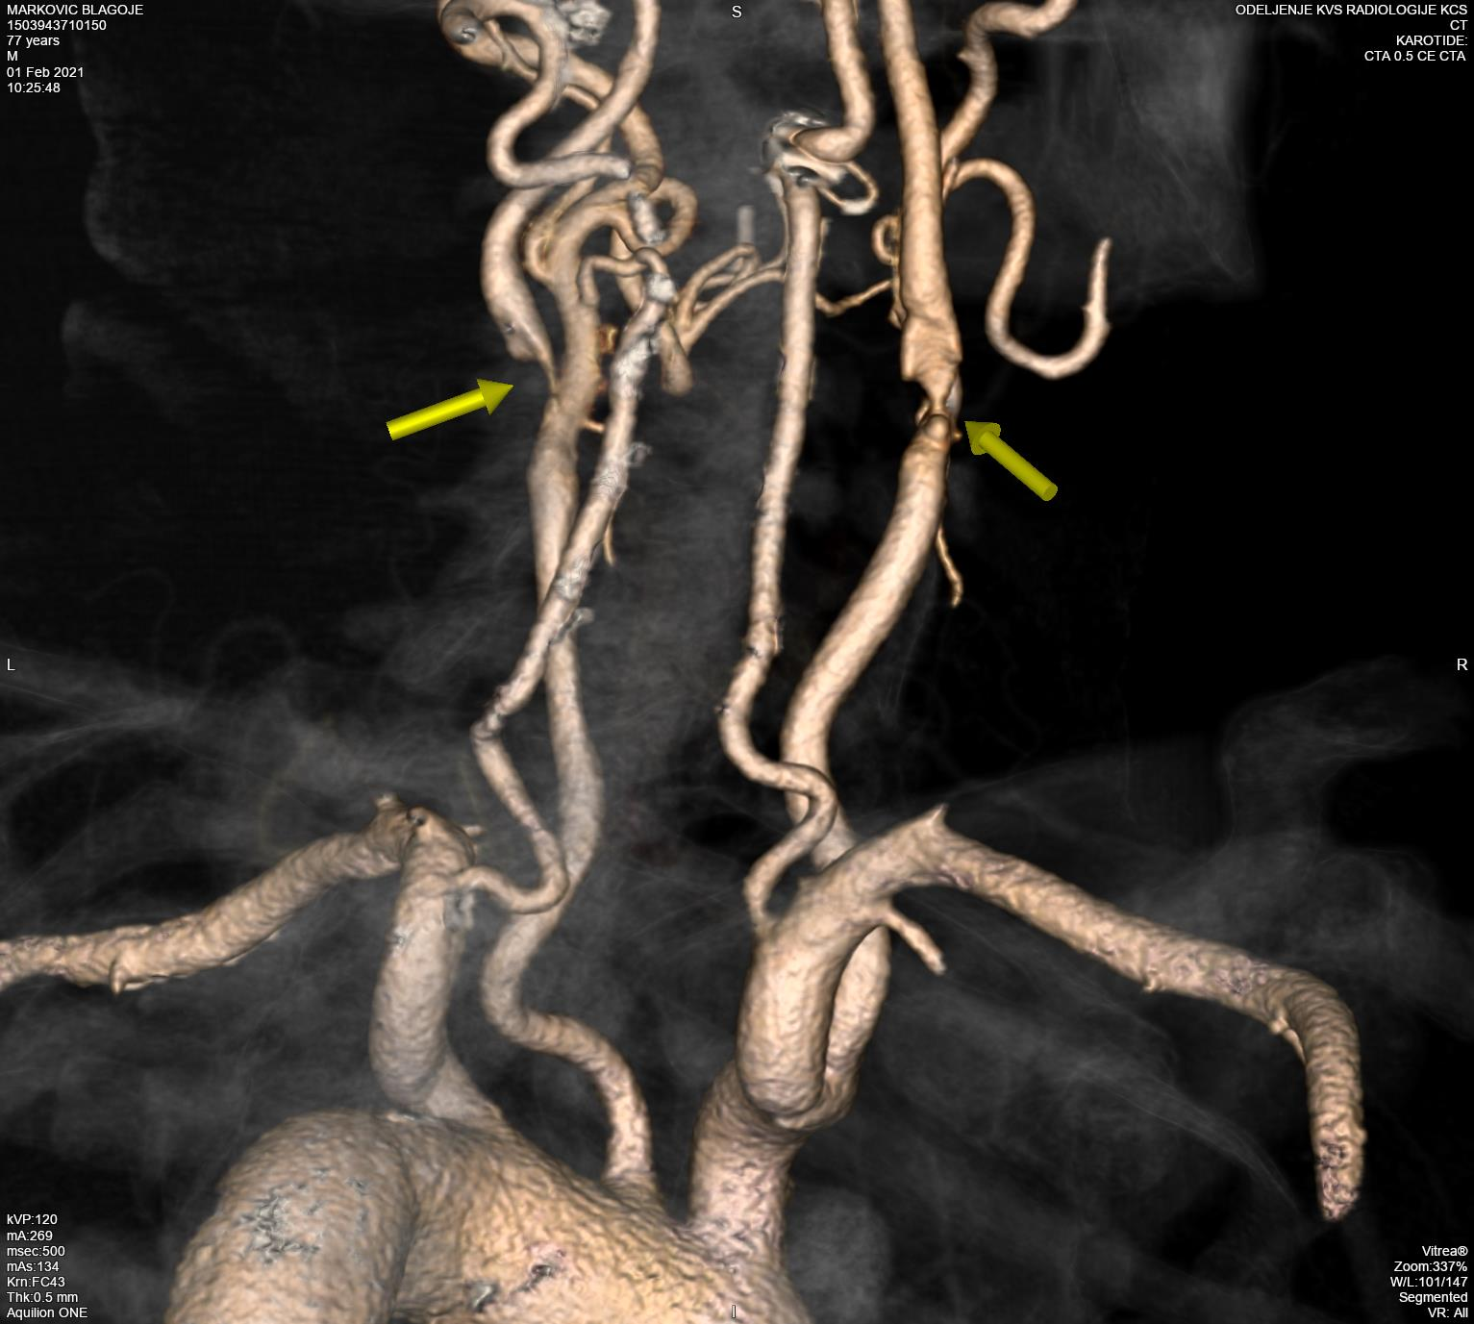

5. Contralateral Carotid Diseases
Ann Surg 2003, 238:551-562.
•Contralateral carotid disease is additional
reason for the treatment of ipsilateral ACS.

Slide 22
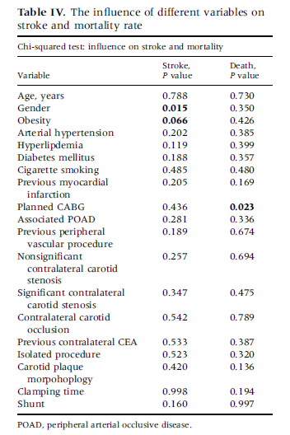
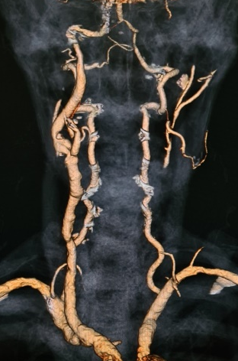
Ann Vasc Surg 2015, 29 (6):1286-1292.
5. Contralateral Carotid Disease

Slide 23
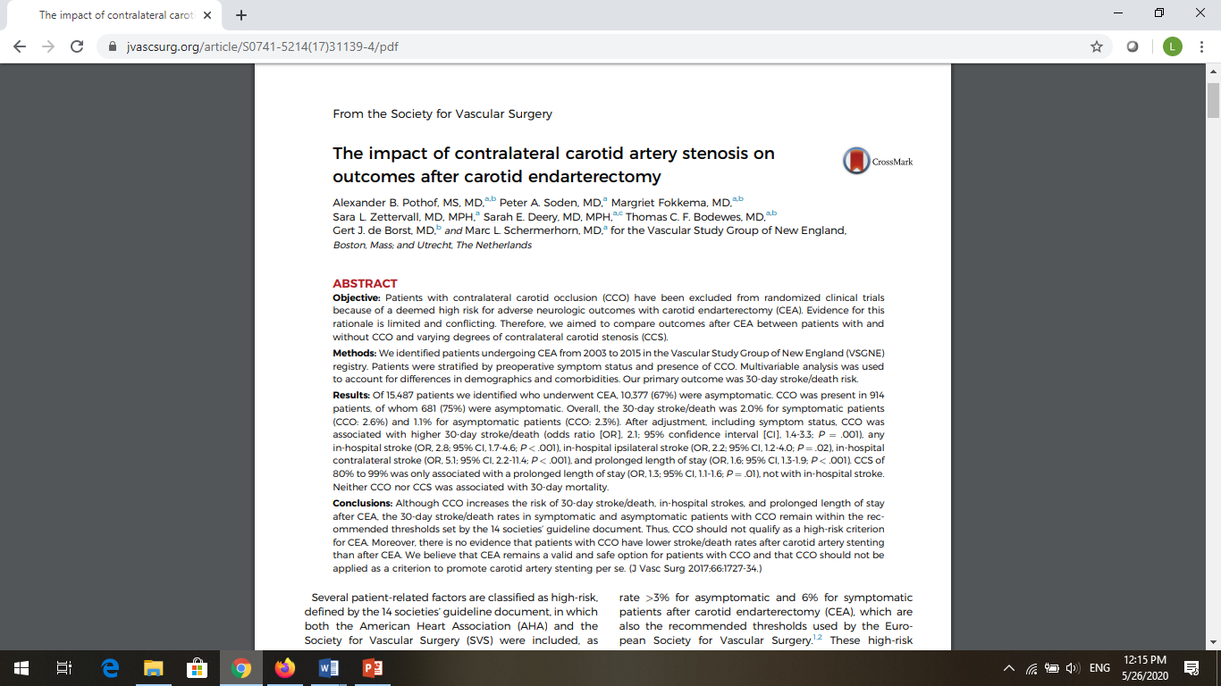
J Vasc Surg 2017;66:1727-34.

Slide 24
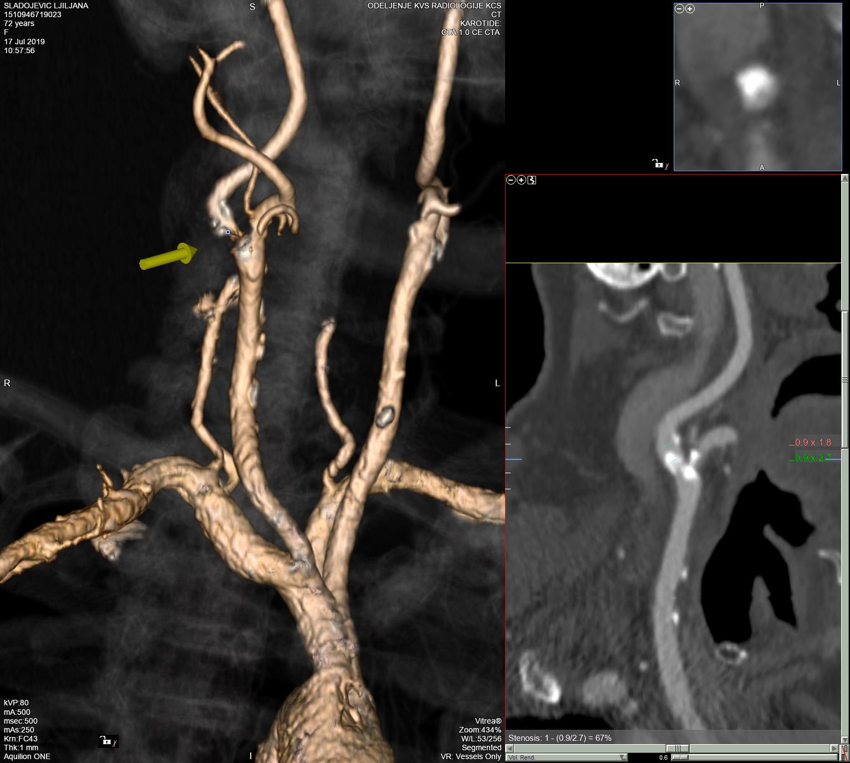
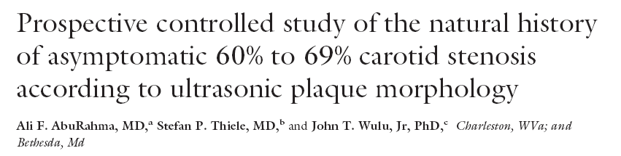
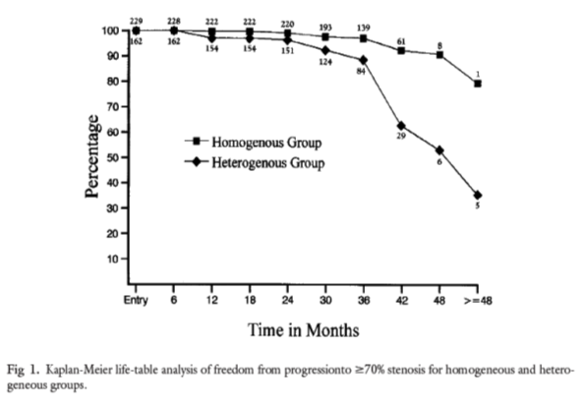
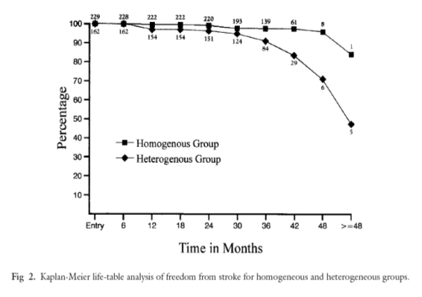

J Vasc Surg 2002, 36: 437-42.
6. Carotid
Plaque
Morphology
p <0.0001
p <0.0001
•The unstable plaque is additional reason for CEA
in patients with asymptomatic carotid stenosis.

Slide 25






7. Upcoming Major Surgery

Slide 26


Notes:
F

Slide 27




Slide 28

6. Treatment of Asymptomatic Carotid Stenosis
Prior Upcoming Major Surgery
  •Bilateral significant carotid stenosis (70-99%)
  •Contralateral
  carotid occlusion

Slide 29


6. Upcoming Major Surgery
Ann Vasc Surg 2015, 29 (6):1286-1292.

Slide 30

Notes:
T

Slide 31


Surgeon Volume
  Am Coll Surg 2002, 195:814.

Slide 32


Slide 33





Primum Non Nocere
•If we want asymptomatic patients to benefit from carotid surgery, the therapeutic risks have to be limited.

Slide 34



Surgical Risk < 3%
J Vasc Surg 2009, 49:331-9

Slide 35

Ann Vasc Surg 2015, 29 (6):1286-1292.

Slide 36
Conclusions
Intervention for asymptomatic carotid stenosis
• No Obese
• With NO extremely significant comorbidities
• Life Expectancy > 5 years
• Heterogeneous Plaque
• Contralateral Disease
• Major Surgery
•Primum non nocere!
•Low cumulative stroke & mortality rate!!

